Slide 1
612 Final Group Project Presentation
Instructor: Lan Wang
Presented by: Chanyuan Wen, Jingxian Chen,
Pooja Bhansali, Trinh Ba Nguyen, YenTzu Chen
Notes:
-Sarah

Slide 2
Agenda
1
Raw Data Cleaning
2
Data Analyzing (6 questions)
3
Conclusions
4
Suggestions
Notes:
-sarah

Slide 3
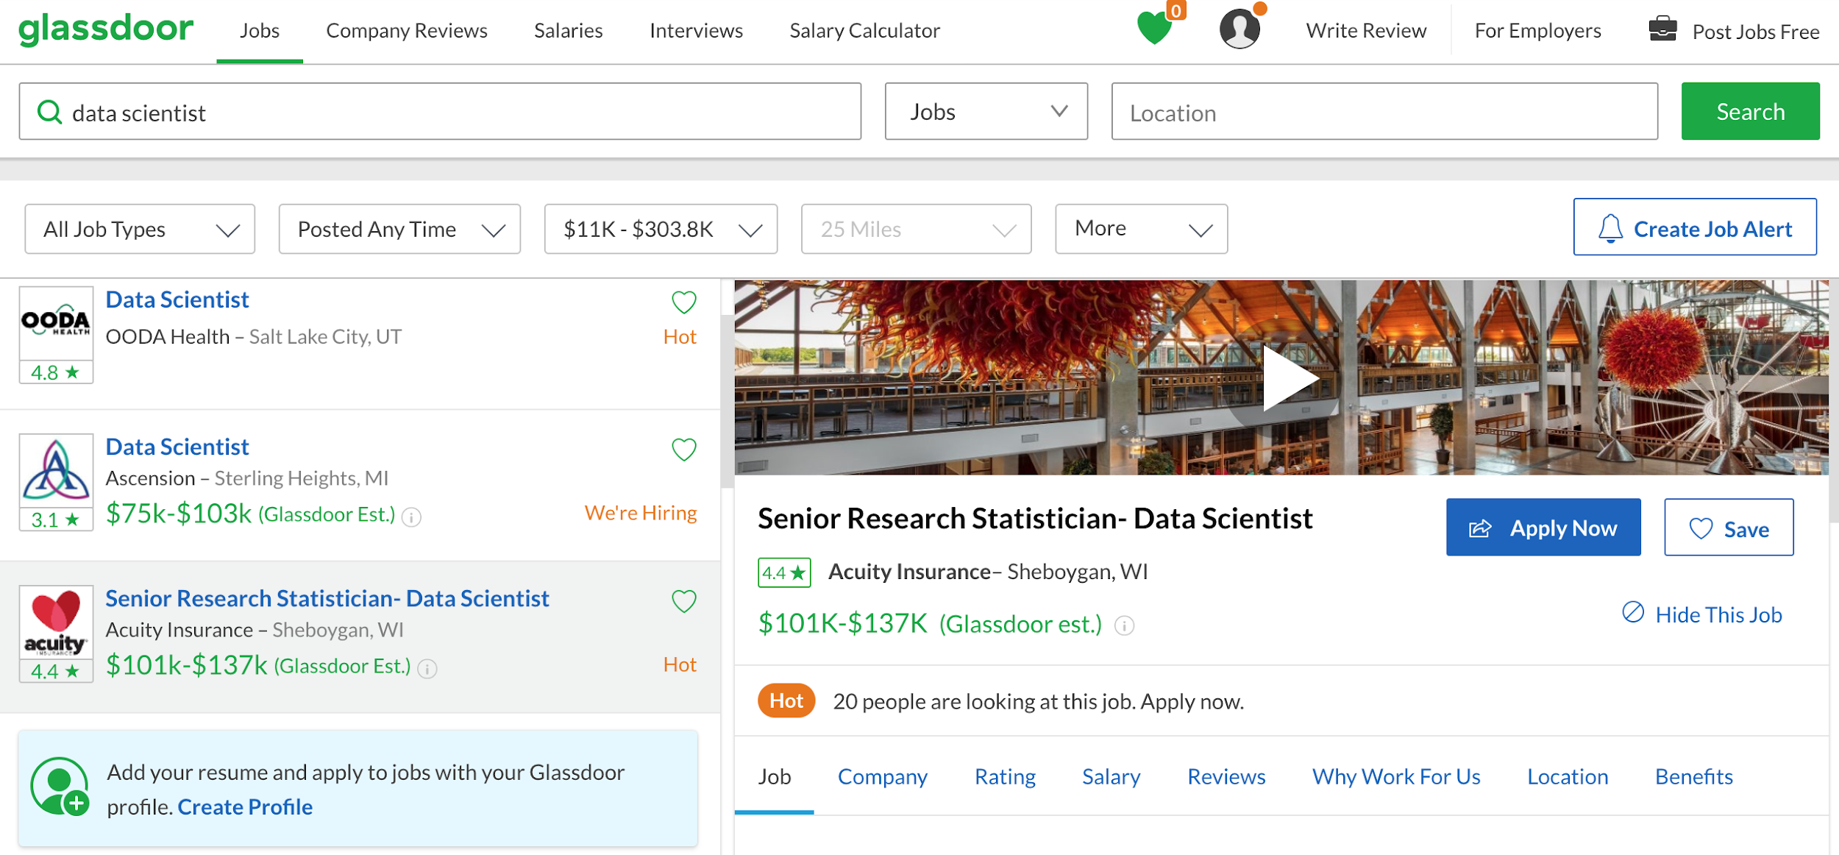
Use the entry URL to get to the below page
Notes:
Trinh

Slide 4
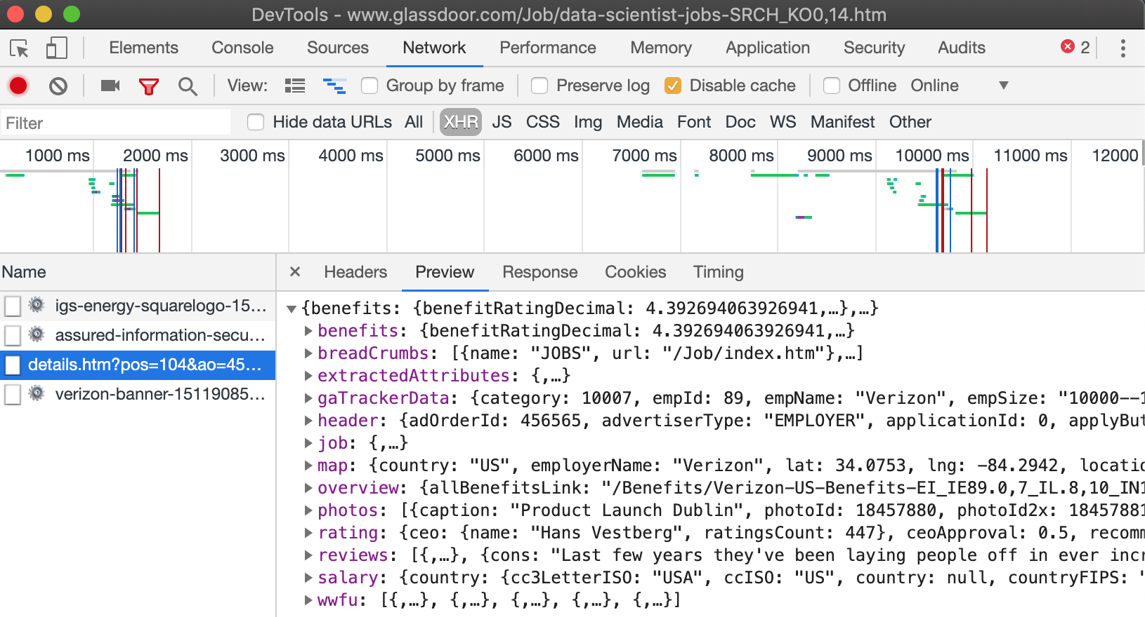
API
of the Data
Notes:
Trinh

Slide 5
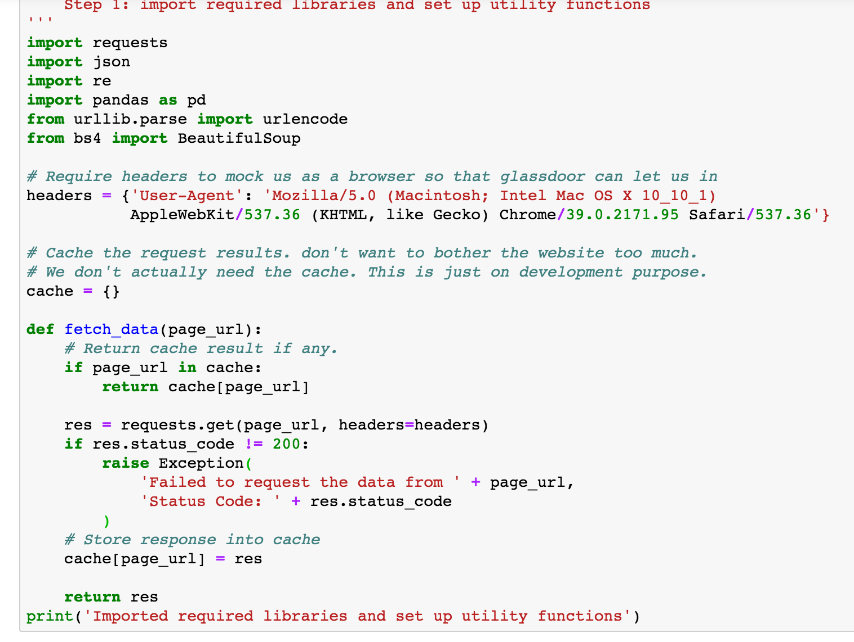
Step 1:
Import required libraries
and set up handle functions
Notes:
Trinh

Slide 6
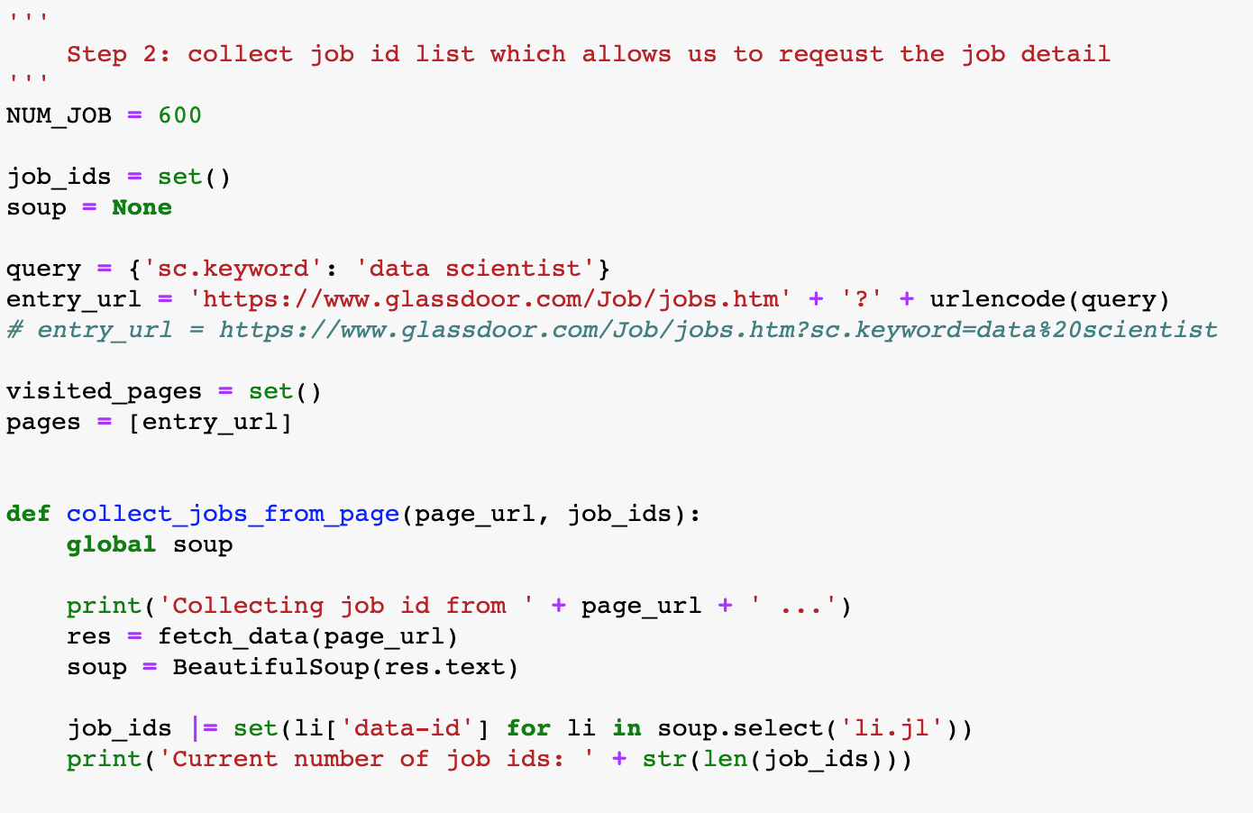
Step 2.1:
Collect job ID list which allows us to request the job detail
Notes:
Trinh 5-12

Slide 7
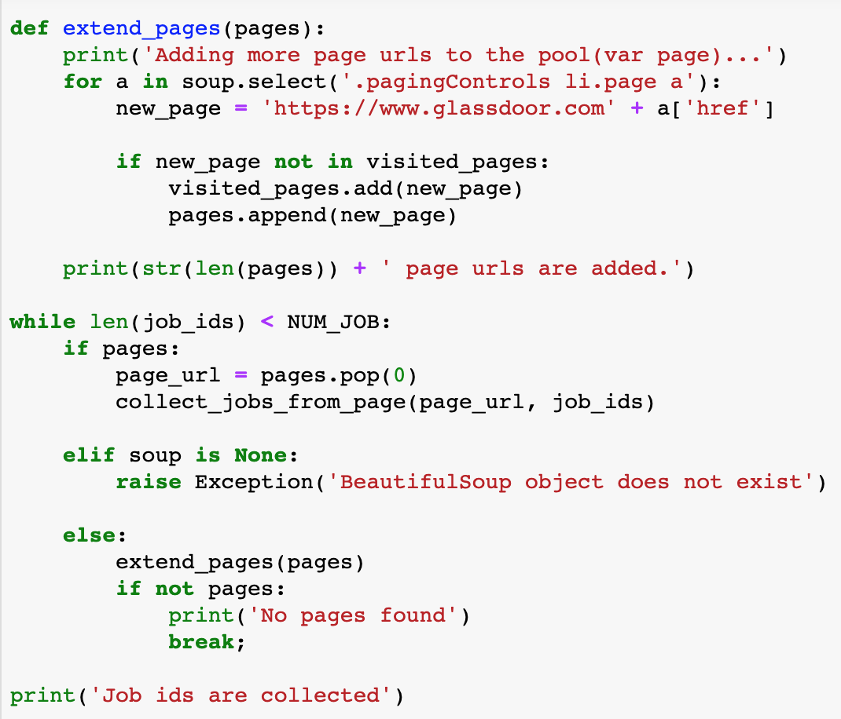
Step 2.2:
Collect more job IDs by extending searching pages
Notes:
TRinh

Slide 8
Raw Data Cleaning
Scraping Data from Glassdoor
Delete or modify incomplete or inaccurate parts of the data

Slide 9
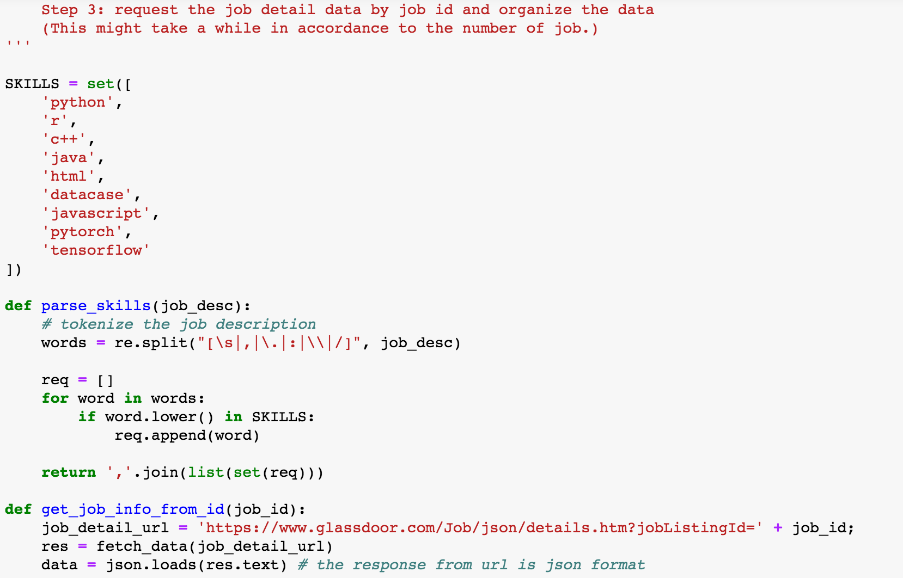
Step 3.1:
Request job detail by skills and pull data into JSON format
Notes:
trinh

Slide 10
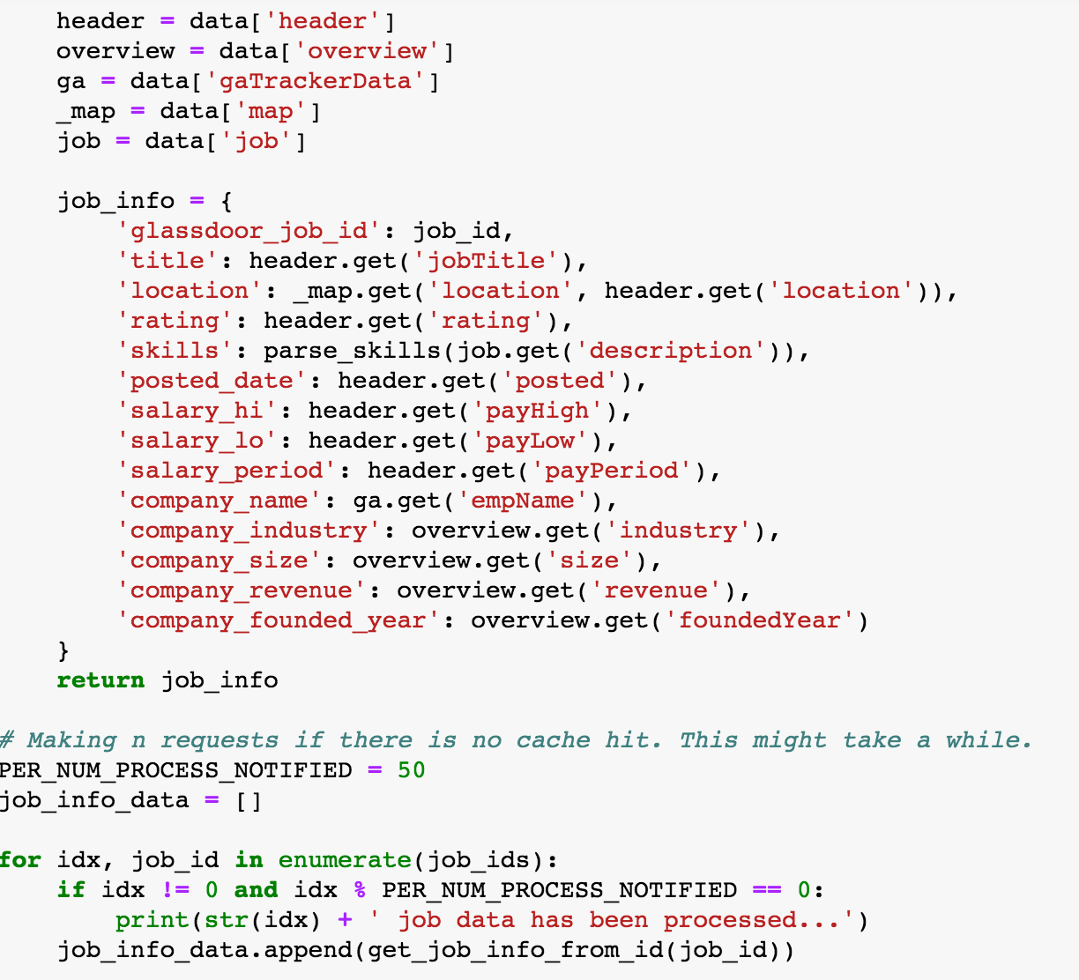
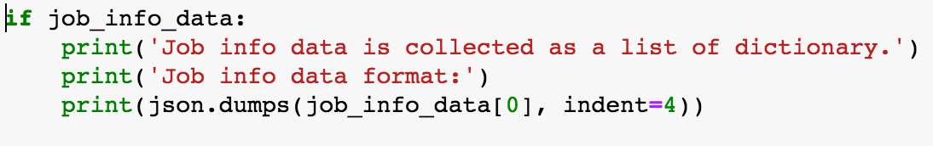
Step 3.2:
Organize the data
Notes:
trinh

Slide 11
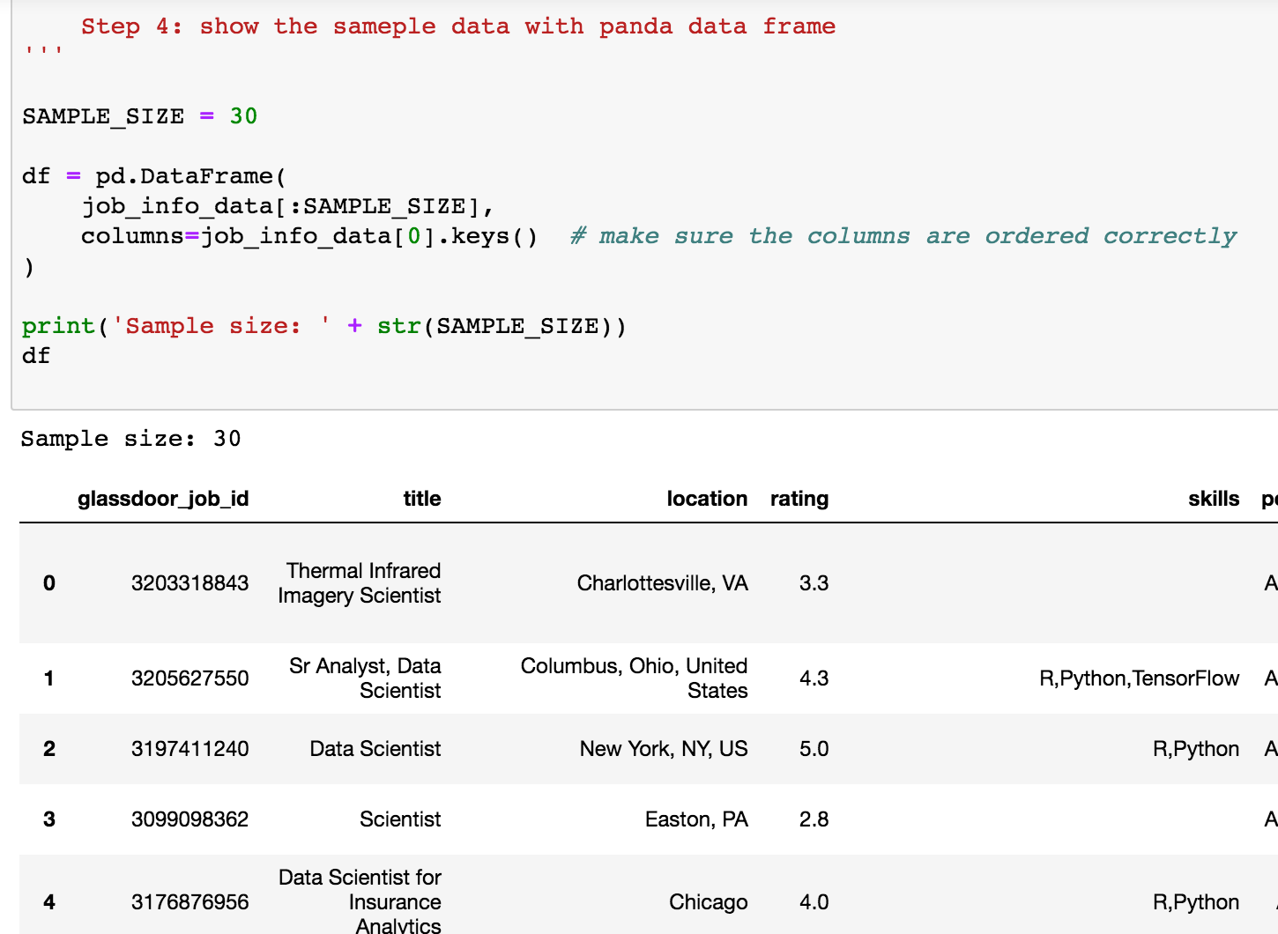
Step 4:
Show the sample data with pandas dataframe
Notes:
Poja

Slide 12

Data Analyzing
Notes:
Pooja

Slide 13
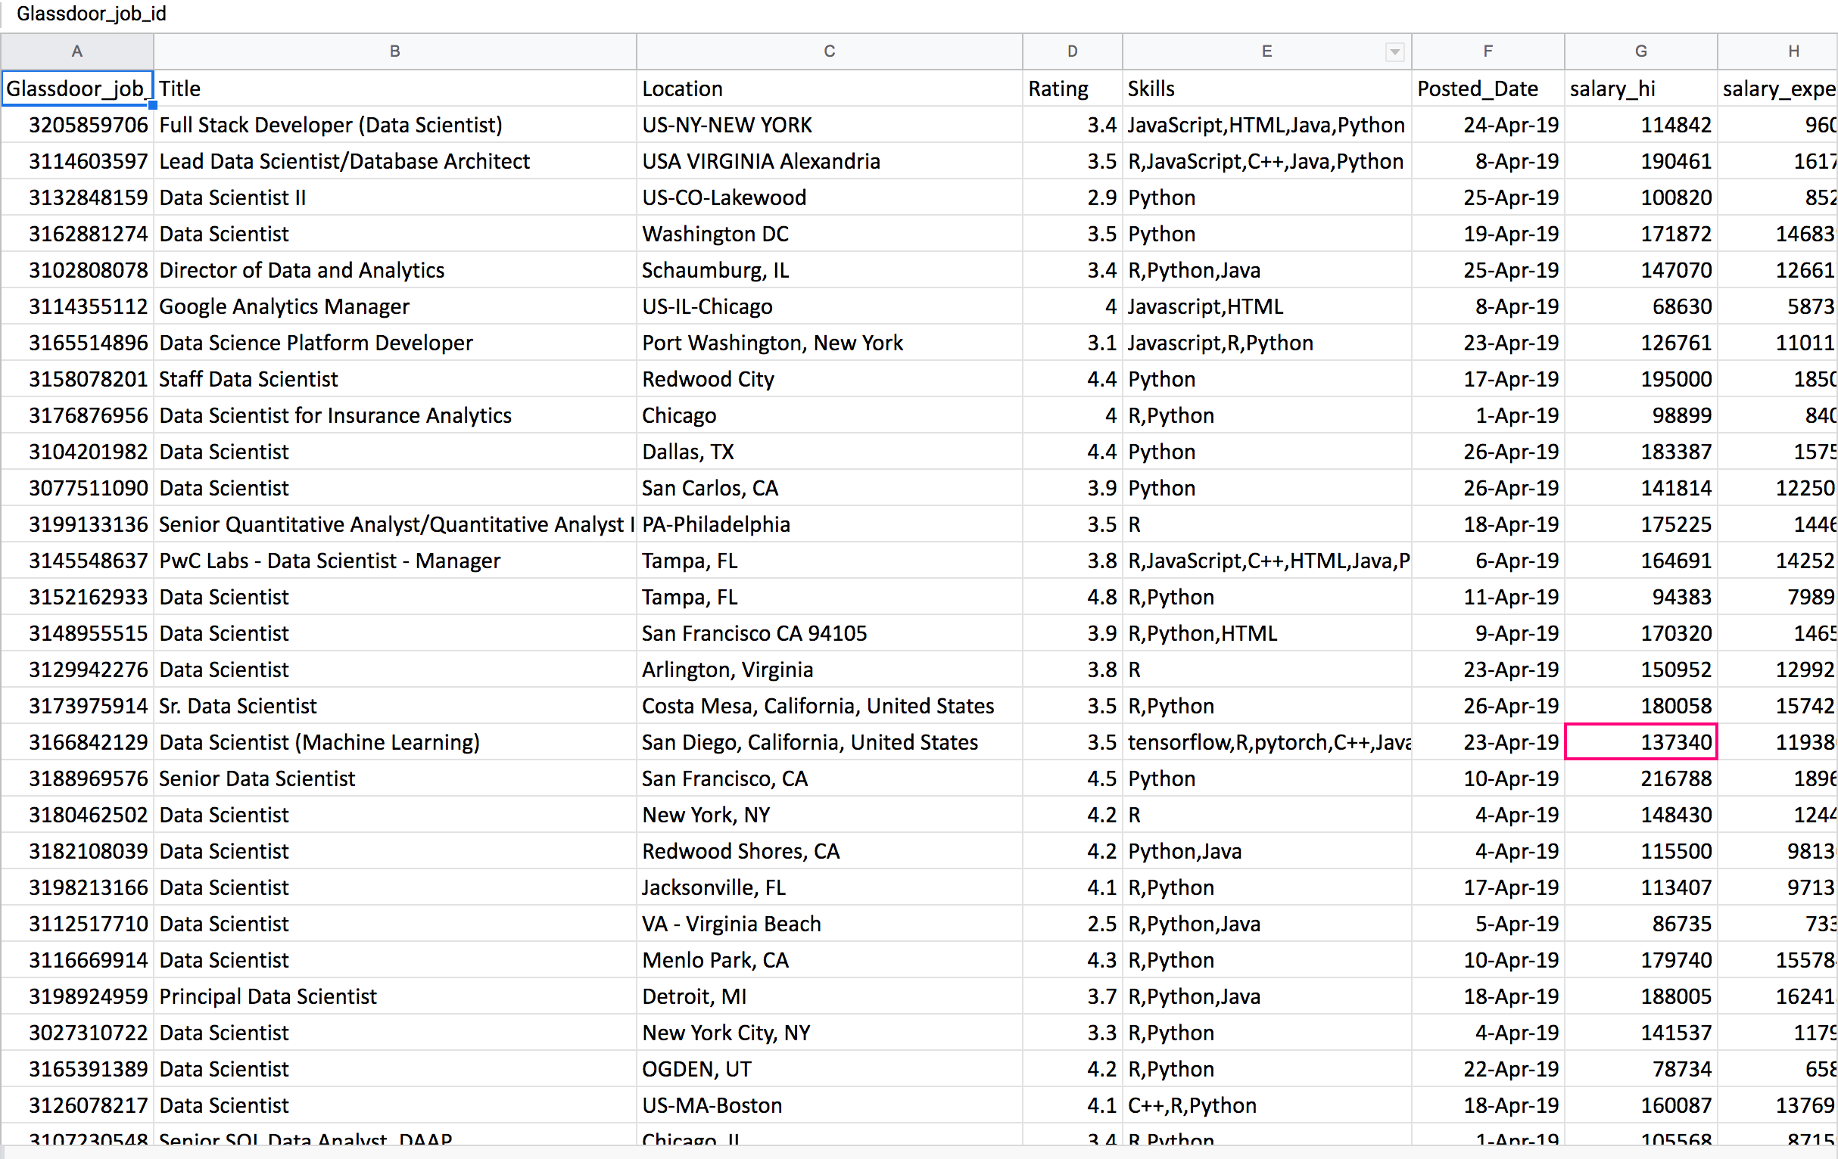
Raw Data Collected
Notes:
Pooja-
After collecting/scrapping the data and Delete or modify incomplete or inaccurate parts of the data.
This data is well -structured.

Slide 14
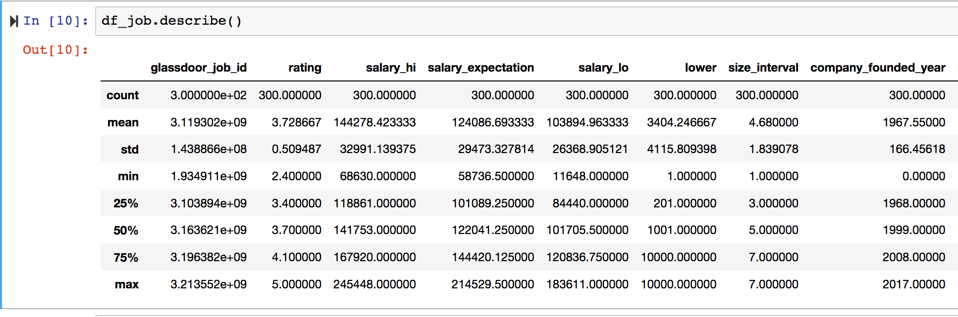
Notes:
Pooja
Statistics summary

Slide 15
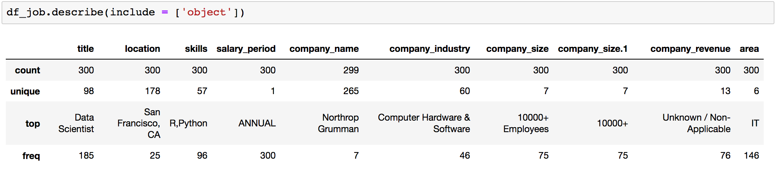
Data Scientist is the highest title from our site with frequency of different titles
The most employees are from San Francisco, CA
The most common skills most of employees have R, Python
Salary period of employee is Annually.
The Most Common Company Industry where employees are from Computer Hardware and software.
Top Company Size is 10000+
The most common area for employees is IT.
Notes:
Pooja

Slide 16
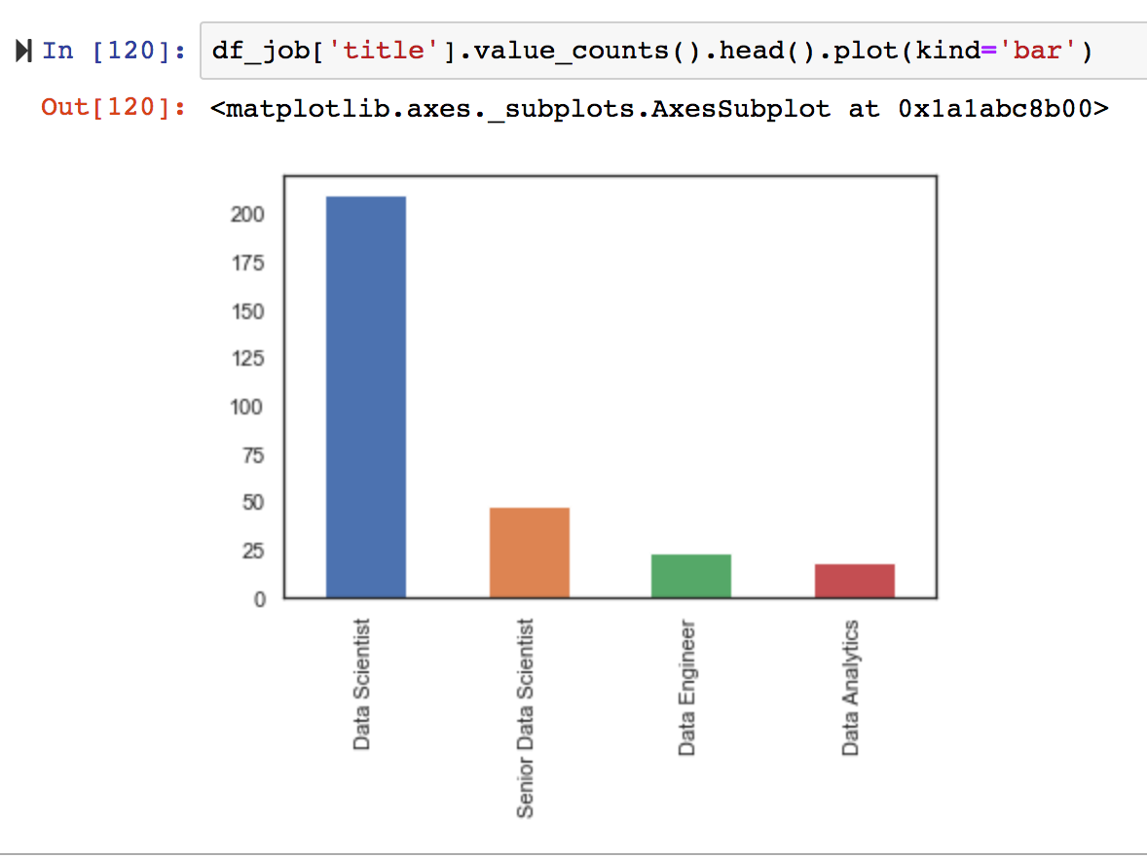
210
From our data sets most of the employees are Data Scientist and few employees are from Data Analytics.
48
24
18
Notes:
Pooja

Slide 17
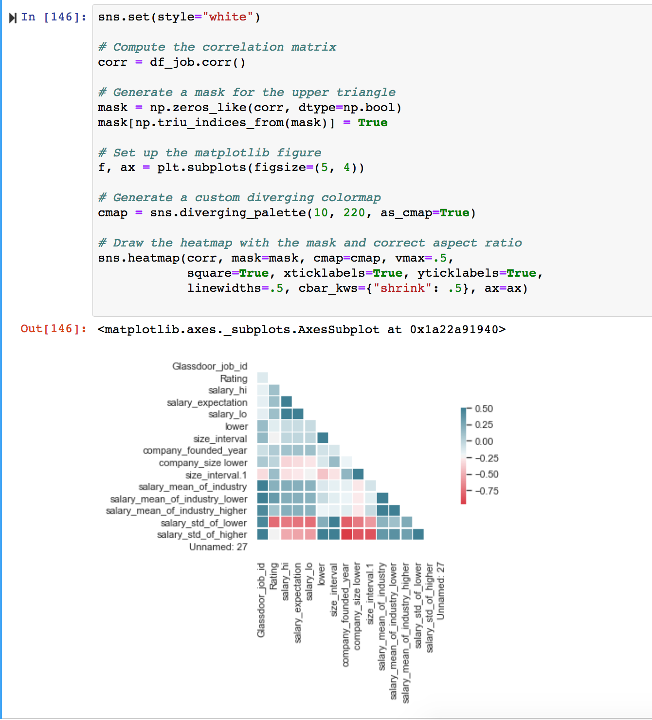
Dark Blue color 0.50 have a strong/high correlation matrix
Notes:
Pooja-
correlation coefficients between variables.

Slide 18
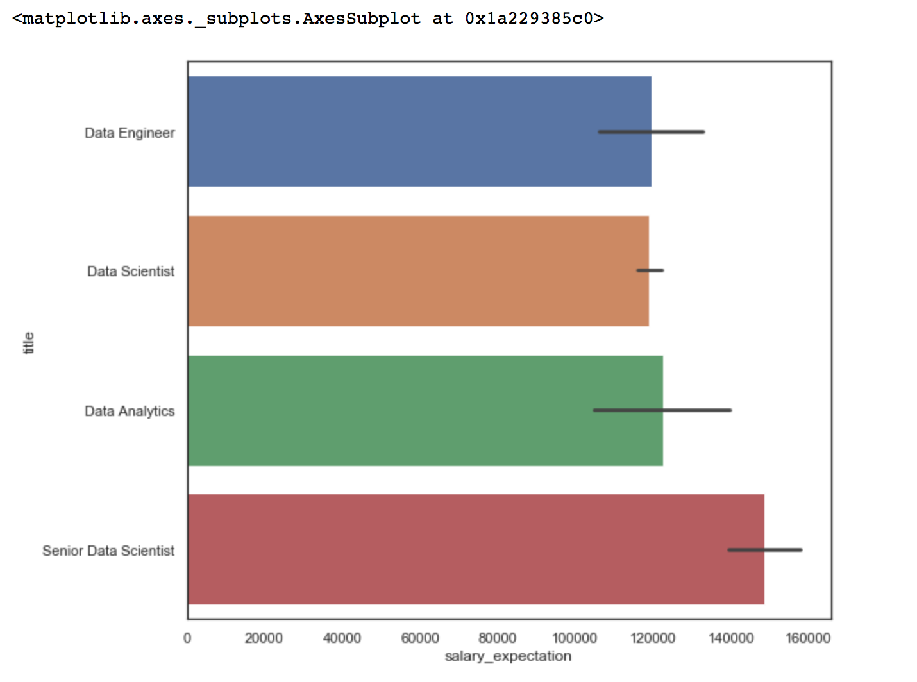
Senior Data Scientist have high salary expectation.
Data Engineer and Data Scientist both have equal salary expectation.
Data Analytics have around $120000 salary expectation.
Notes:
Pooja-
The employer will very likely want a specific number, so another strategy is to give them a number or a range.
The difference in pay is significant, more pay does work and sometimes not.

Slide 19
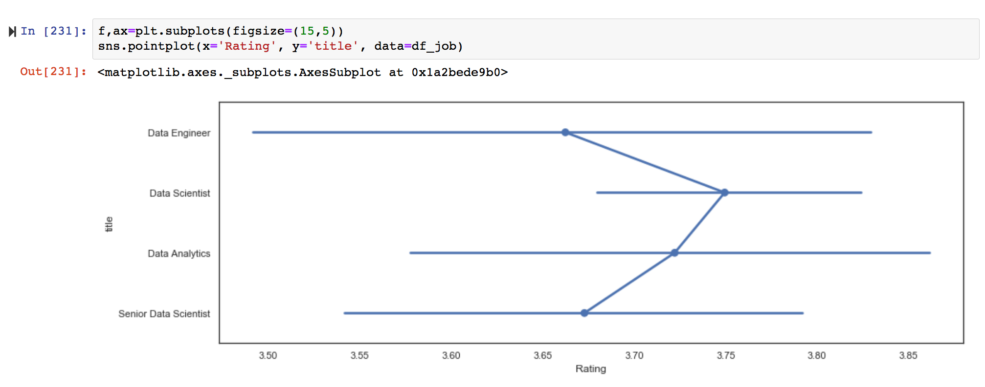
TITLE VS RATING
Data Scientist have a higher rating 3.75
Data Analytics have a rating 3.70
Senior Data Scientist have a rating 3.65
Data Engineer have a rating 3.60
Notes:
Pooja

Slide 20
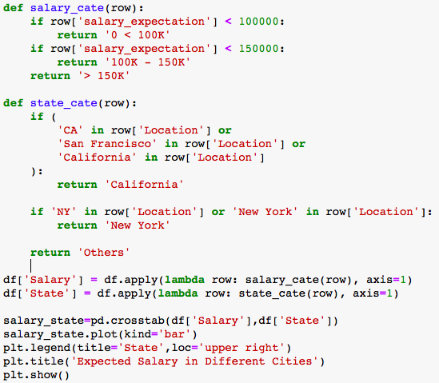
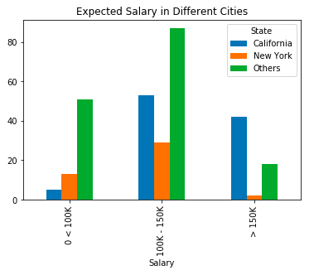
Expected Salary in CA, NY, & Other Cities
California has LOWEST expected salary (<100k) for Data Scientist than NY & other cities in US
California has HIGHEST expected salary (>150K) for Data Scientist than NY & other cities in US
Notes:
-Sarah

Slide 21
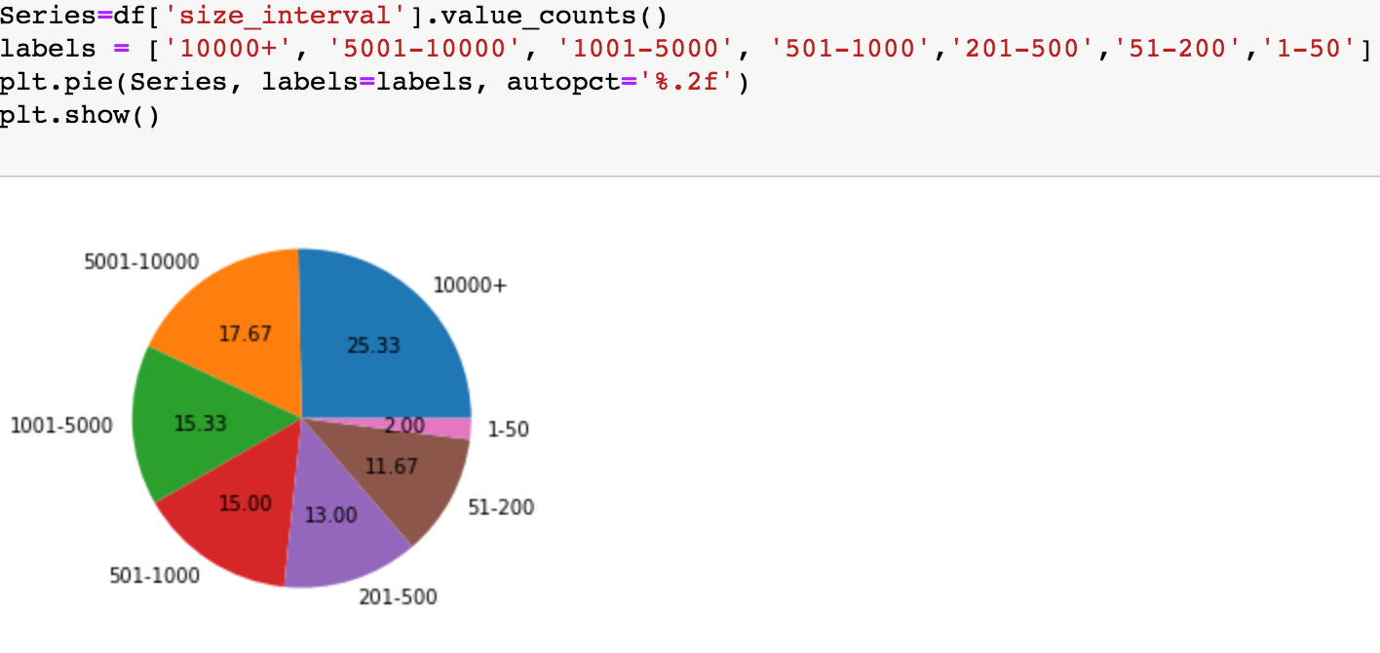
Company size distribution
Massive companies hold the largest proportion of all
Notes:
Chanyuan

Slide 22
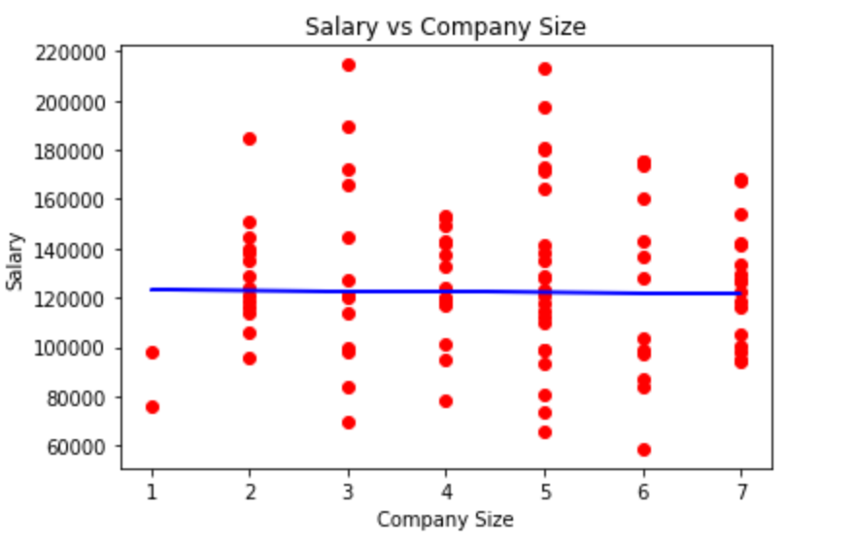
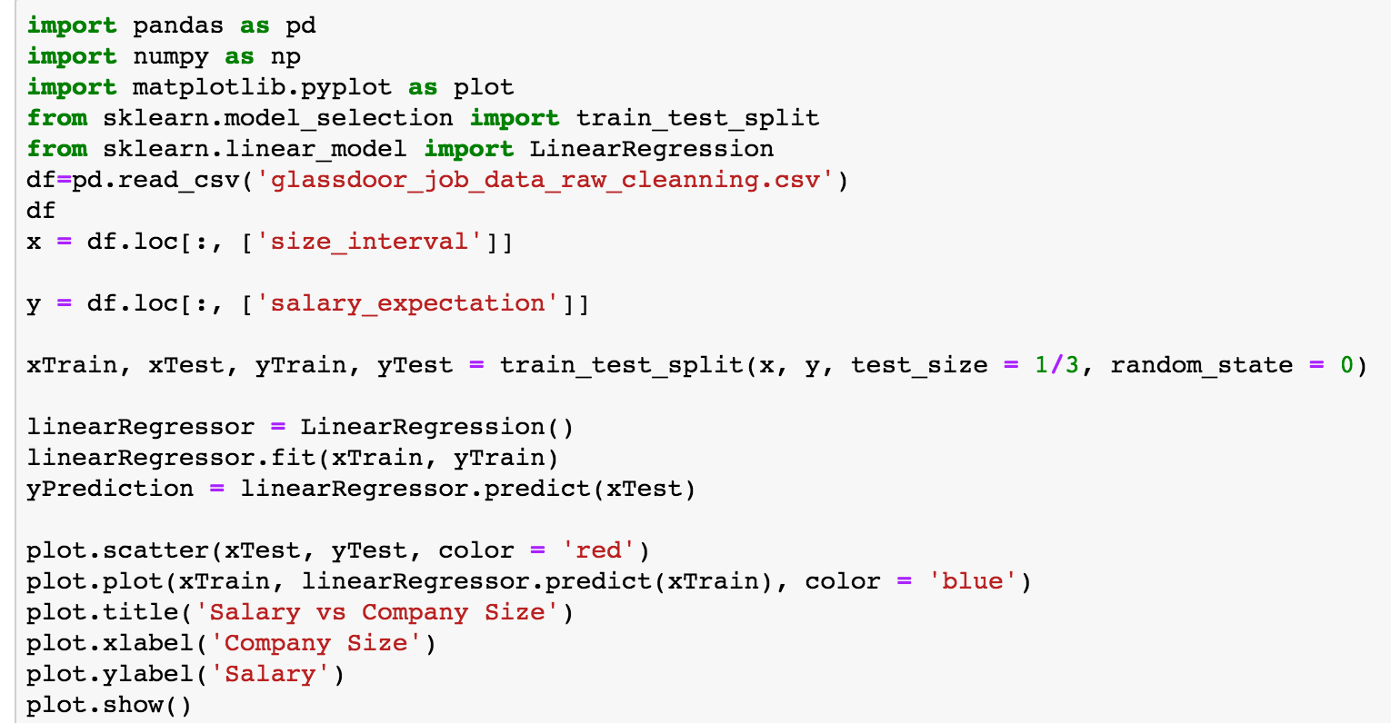
Company Size VS. Salary Expectation
Notes:
Chanyuan

Slide 23
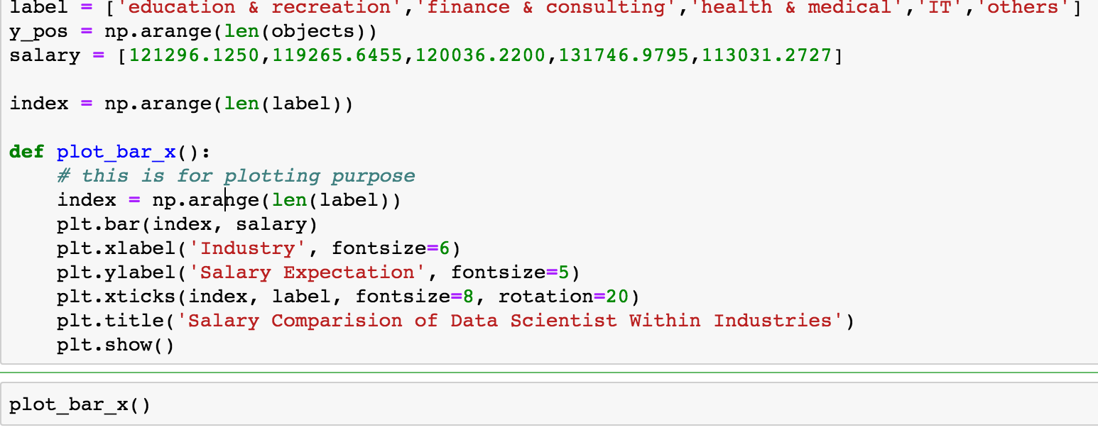
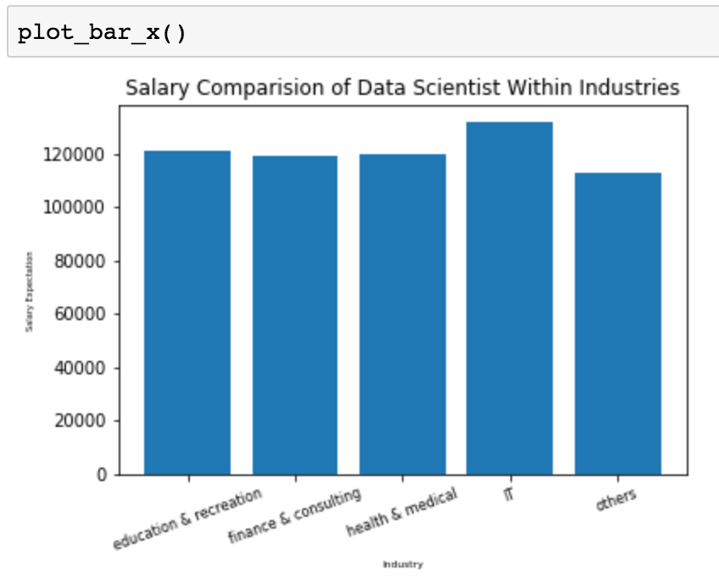
Industry vs. Salary Expectation
Notes:
Chanyuan

Slide 24
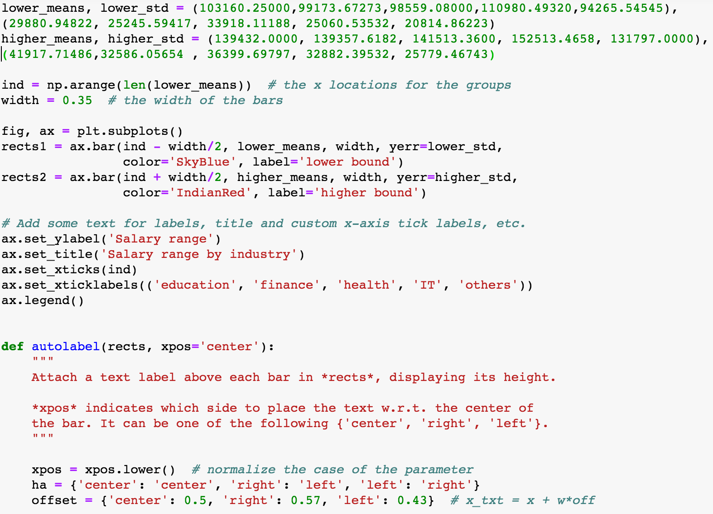
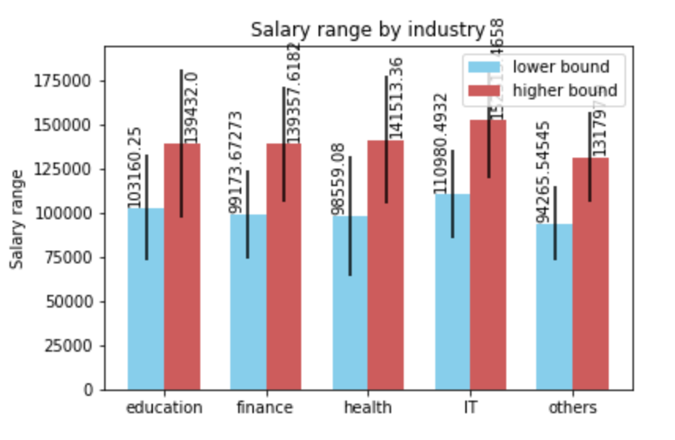
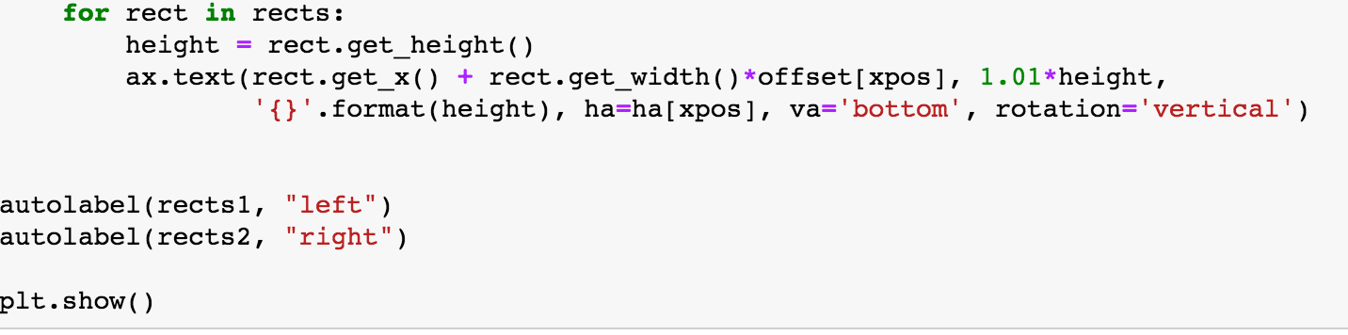
Industry VS. Salary Gap
Notes:
Chanyuan

Slide 25
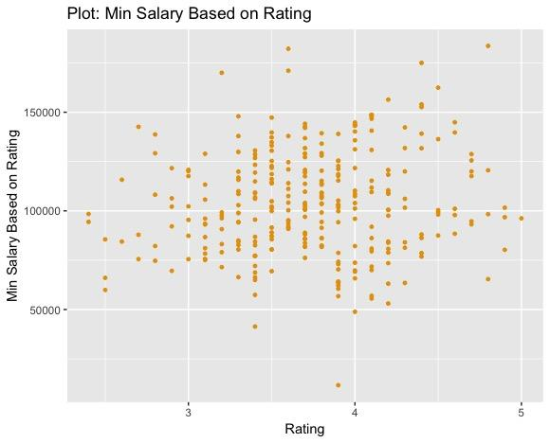
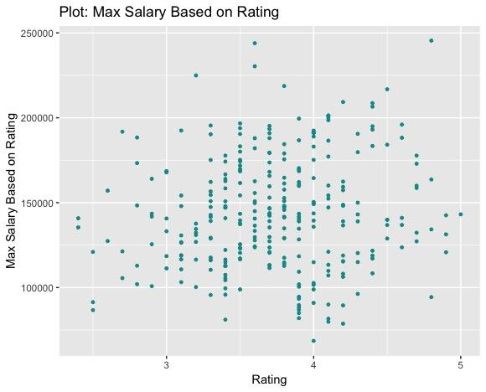
Company Rating vs. Salary
Notes:
trinh

Slide 26
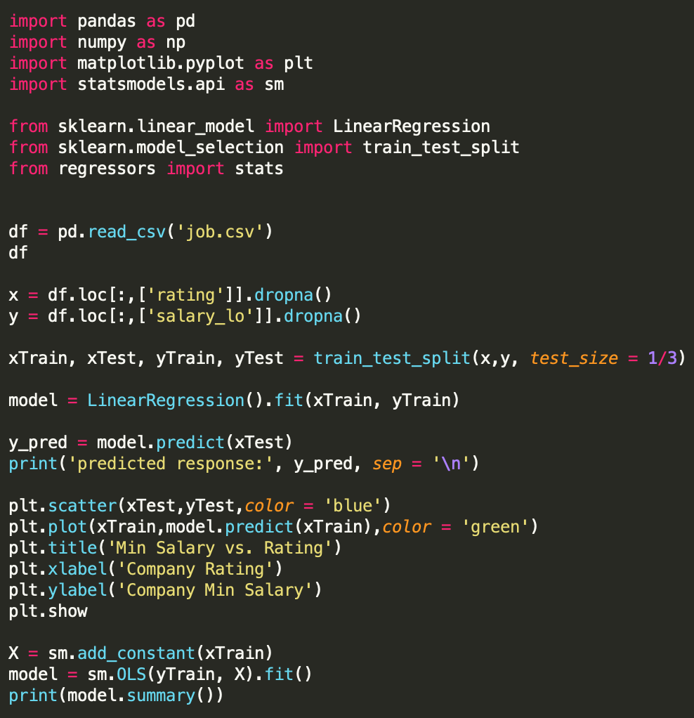
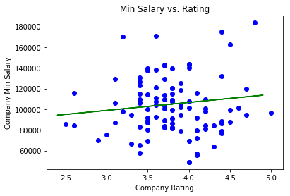
Regression of Min Salary on Rating
Notes:
trinh

Slide 27
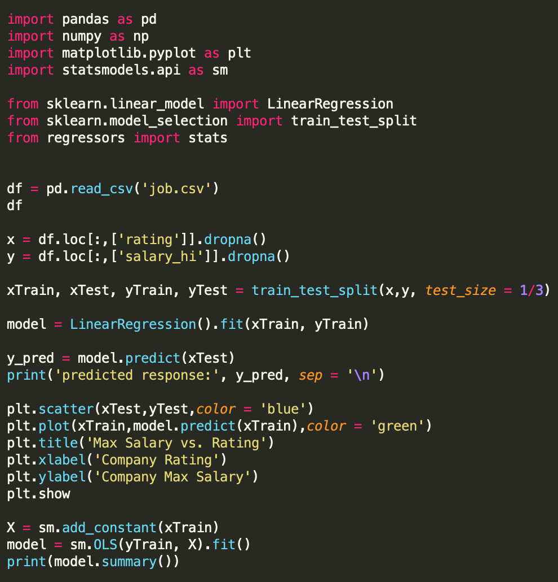
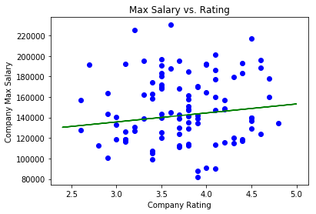
Regression of Max Salary on Rating
Notes:
trinh

Slide 28
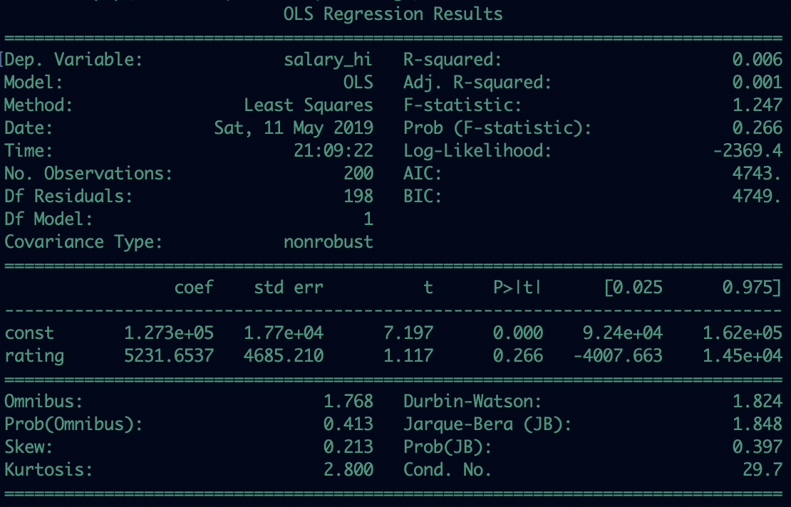
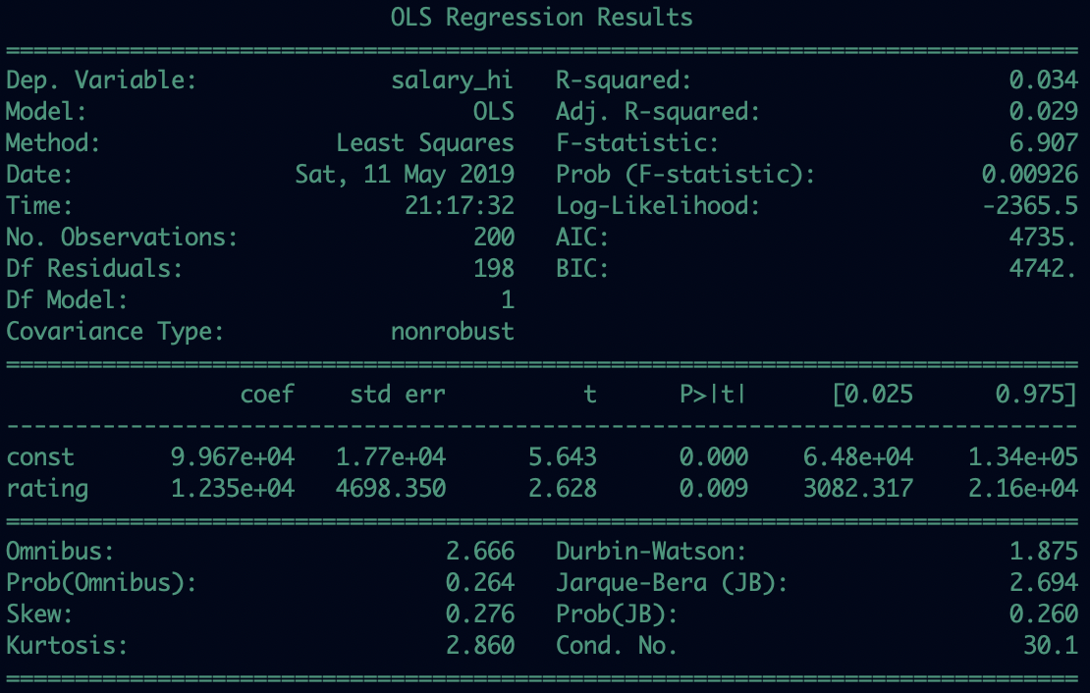
Statistical Results:
Min Salary on Rating
Max Salary on Rating
Notes:
trinh

Slide 29
Empirical results:
Salary Expectation that an employee can earn from a particular company appears to be positively correlated to the rating of the company.
P_values in both regressions are relatively small which indicates the rating variable is statistically significant in explaining the salary of a company.
The relationship between the expected salary and rating of a company is strong and bi-directional.

Slide 30
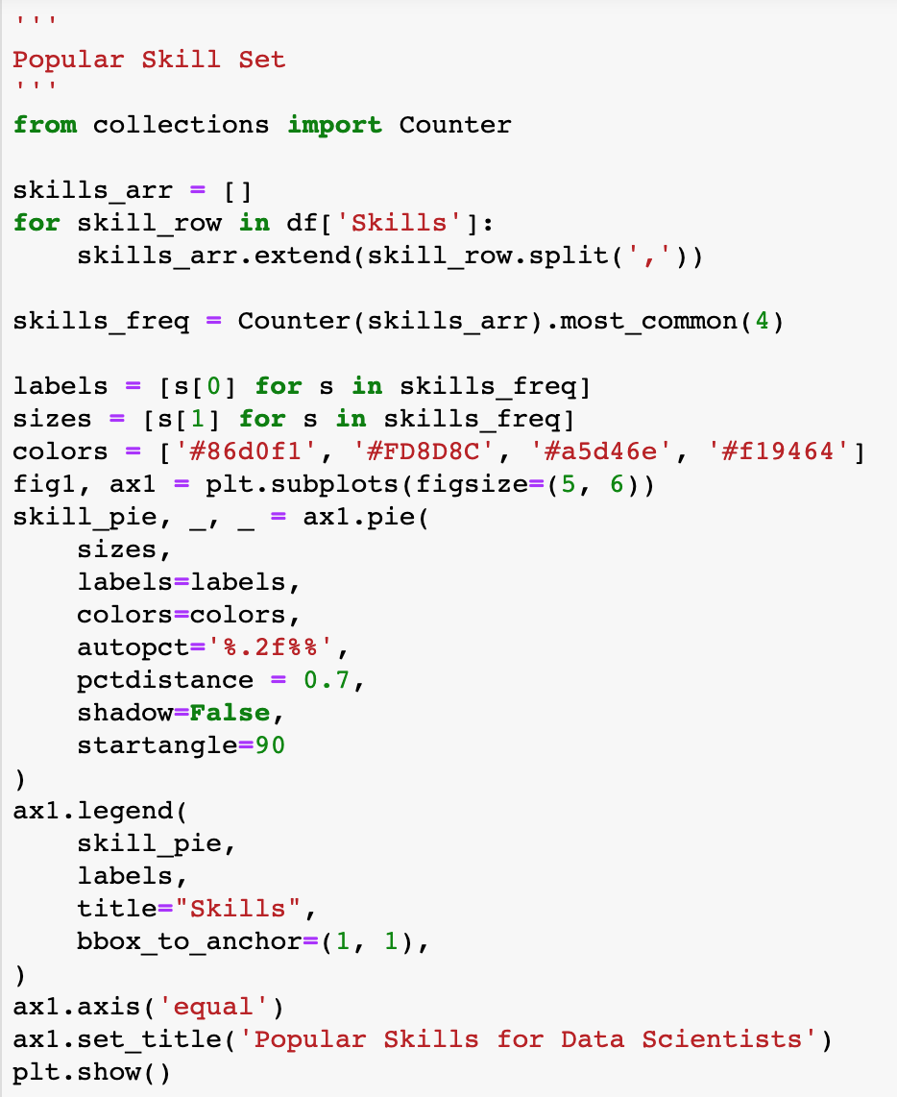
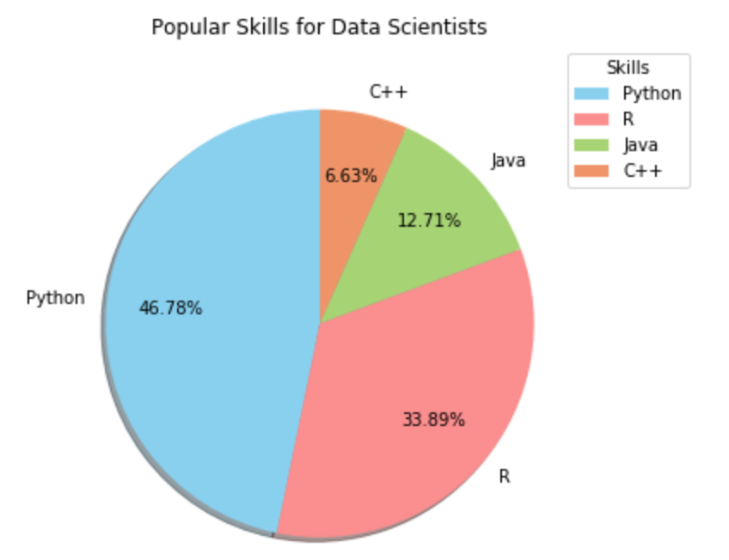
Skills
The most commonly used Programming language is Python.

Slide 31
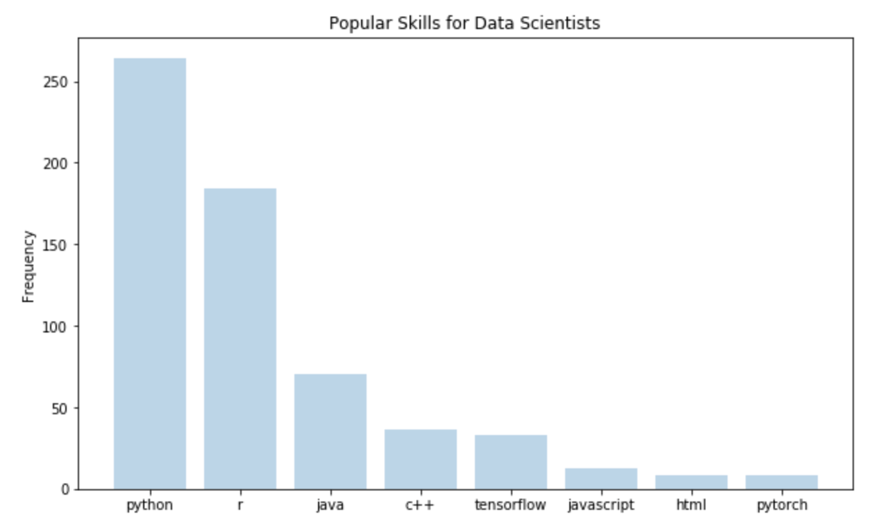
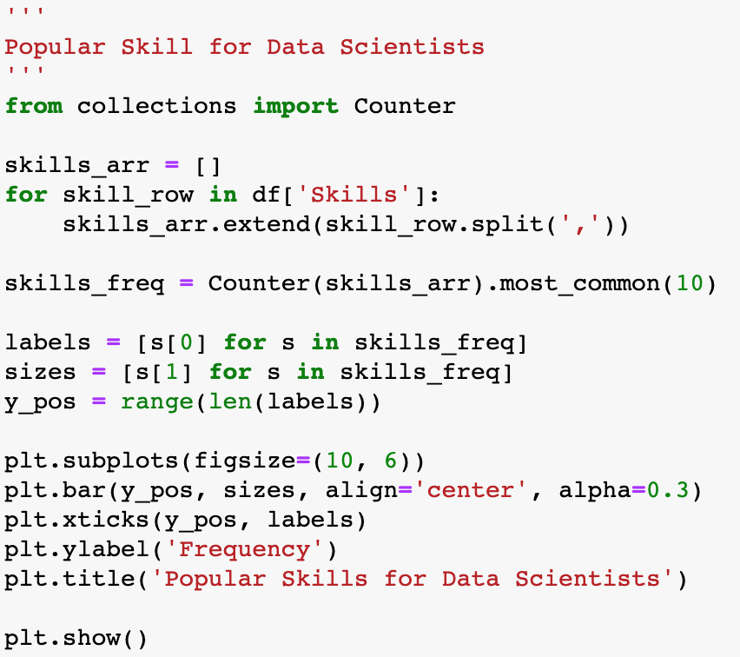
Popular Skills for Data Scientists
These programming skills are more popular for data scientists.

Slide 32
Conclusion
From our Datasets, most of the Employees are Data Scientists
Senior Data Scientist have high salary expectation
Data Scientists have a higher rating 3.75
The most commonly used Programming language is Python
California has HIGHEST expected salary (>150K) for Data Scientist than NY & other cities in US
Company size is neither positively nor negatively correlated with Salary Expectation
IT industry has the highest salary expectation
There is a significant and bi-directional positive correlation between the expected salary and the company rating
Notes:
YenTzu

Slide 33
Look for a place with strong data science teams, to get good mentorship
Data science is a huge field — you’ll never stop learning
Stay in California (Bay Area) for higher paying jobs
IT industry is your best choice
Don’t enter start-ups with 1-50 staff to avoid being underpaid
Aim for higher rating companies
Master Python & R
Suggestions

Slide 34
Thank You!
Q&A

